Slide 1
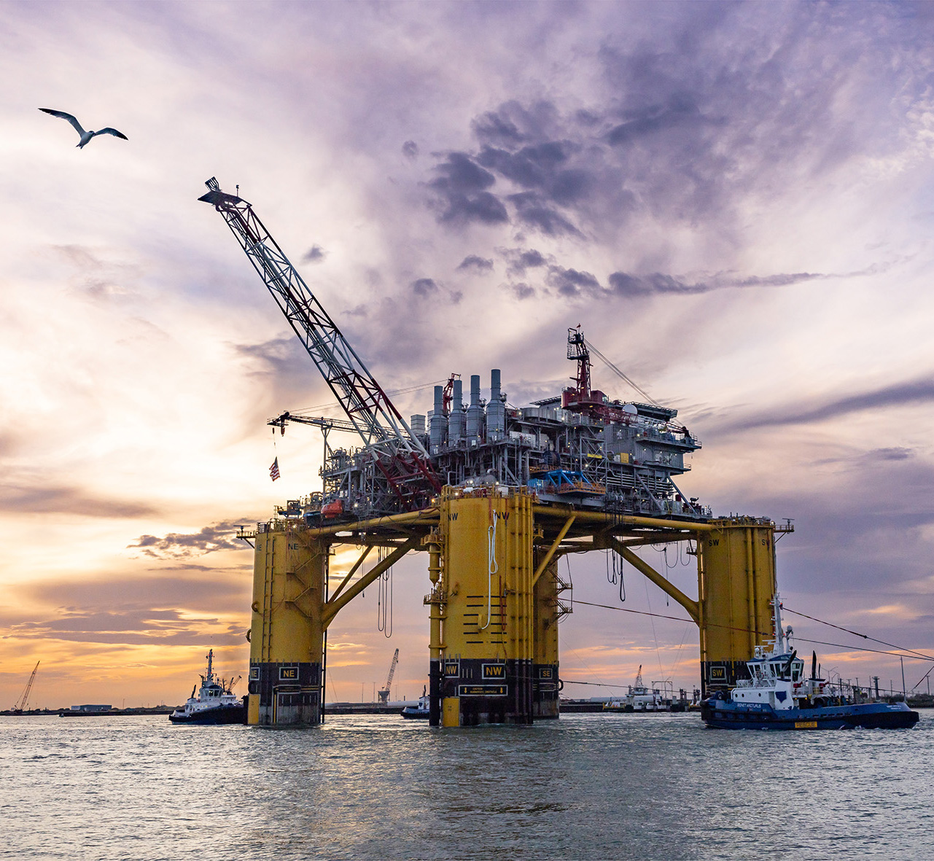
Liquified Natural Gas
Introduction to Liquified Natural Gas

Slide 2

Agenda
01
Understanding LNG
02
Prelude
03
Life Cycle of LNG
Environment Issues
06
Technological Advancements
04
Case Study
05
Copyright of Shell International B.V.

Slide 3
Understanding LNG

Slide 4
Overview of LNG
Liquified Natural Gas
LNG represents a Technological revolution in the energy landscape
Volume reduced to 1/600th of its original gaseous volume
Advantages of Liquified Natural Gas
Primary Energy Source for Power Plants
Cleaner Combustion and Lower emission
LNG is used as fuel in Shipping industry
LNG is used as a raw material for chemical processes

Slide 5
Prelude

Slide 6
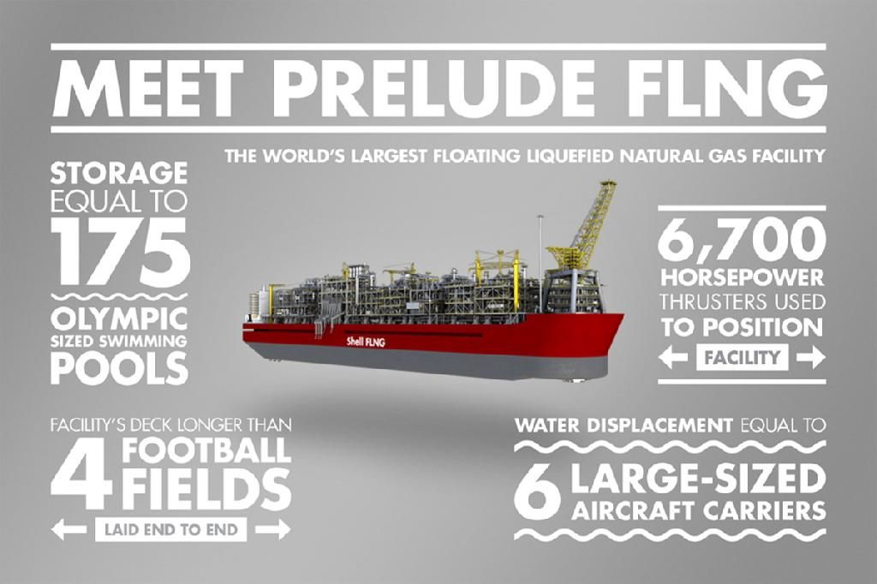

Slide 7
Life Cycle of LNG

Slide 8
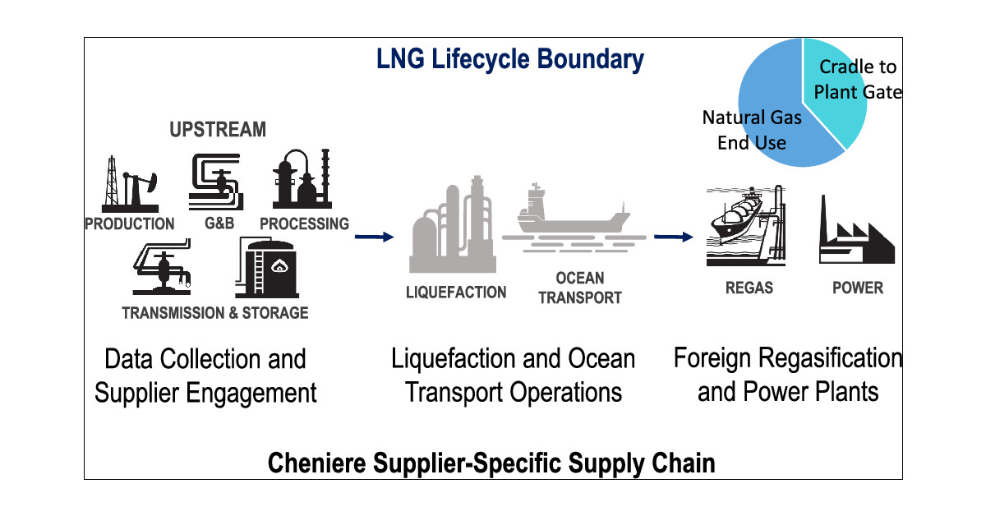

Slide 9
Case Study

Slide 10
Russia – Ukraine War
Europe relies on Russia for 90% of its gas imports
Gas supplies were one of the biggest concerns at that time
Before war Russia accounted for 40% of total supplies of Gas
Russia started cutting pipelines supplies to Europe in 2021
Gas prices surged in Europe
Europe started building 17 LNG Terminals

Slide 11
Environmental Issues

Slide 12
Impact on Environment
Methane Emissions
Energy – Intensive Liquification Processes
Air Pollution
Risk of Spills and Explosions

Slide 13
Technological Advancements

Slide 14
Technological Advancements
Floating LNG
LNG Bunkering
Cryogenic Technology Improvements

Slide 15
Q&A

